Slide 1
AXI VIP
Prepared By : Pavan Kumar Gunnamsetti
Email : pavankumargunnamsetti@gmail.com
Mobile : +91 6300137271

Slide 2
AXI Introduction
AXI, or Advanced eXtensible Interface, is a high-performance interface protocol developed by ARM for connecting components in System-on-Chip (SoC) designs. It is part of the AMBA (Advanced Microcontroller Bus Architecture) specification, which aims to standardize communication between various blocks in a chip.

Slide 3
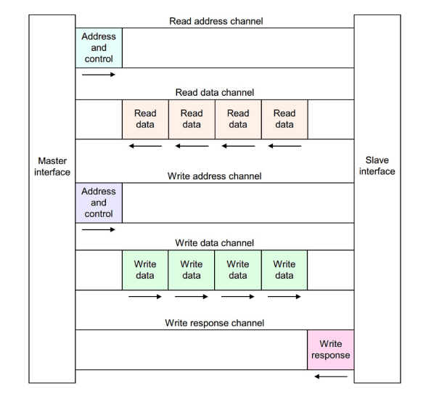
Overview of AXI
The AXI utilizes dedicated channels for data, address, and control signals to facilitate efficient communication between masters and slaves.
Write Address Channel
Write Data Channel
Write Response Channel
Read Address Channel
Read Data/Response Channel

Slide 4
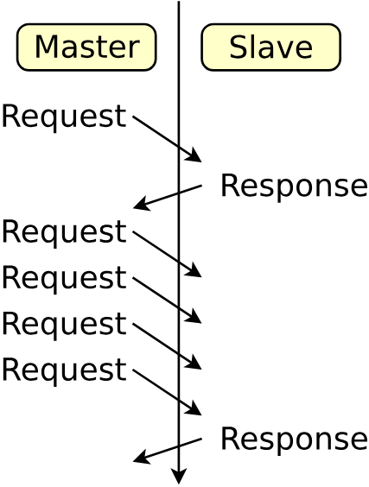
Key Features of AXI
Burst based transaction with start-address
Five channel Architecture
Multiple outstanding Addresses(Multiple request)
Separate channel for read and write operations
Aligned and Non-Aligned Address support
Higher Bandwidth

Slide 5
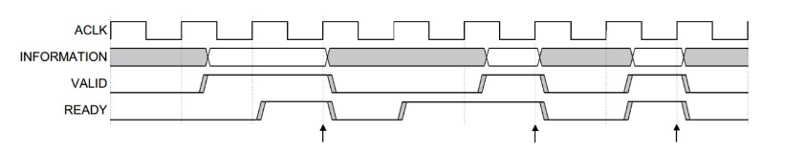
Handshake in AXI
VALID: Indicates that the sender (master or slave) has valid data or an address to send.
READY: Indicates that the receiver (slave or master) is ready to accept data or the address.
The data transfer happens only when both the VALID and READY signals are asserted (set to high).

Slide 6
AXI Signals
Write Address Channel
Write Data Channel
Write Response Channel
Read Address Channel
Write Data Channel
AWID
AWVALID
AWADDR
AWREADY
AWBURST
AWSIZE
AWLEN
WID
WVALID
WSTRB
WDATA
WREADY
WLAST
BID
BVALID
BRESP
BREADY
ARID
ARVALID
ARADDR
ARREADY
ARBURST
ARSIZE
ARLEN
RID
RVALID
RDATA
RREADY
RLAST
RRESP

Slide 7
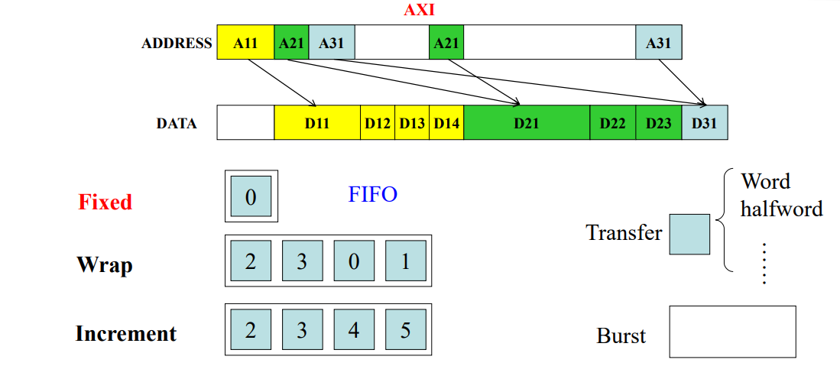
AXI Burst Transfers
AXI supports burst transfers, which allow for multiple data transfers with a single address and control signal, reducing overhead and enhancing efficiency
FIXED LENGTH
Fixed length burst transfer a predefined Number
Data words
INCREMENT
Increment burst transfer data words at sequential addresses
WRAP
Wrap burst transfer data words with Addresses
That wrap around a defined boundary

Slide 8
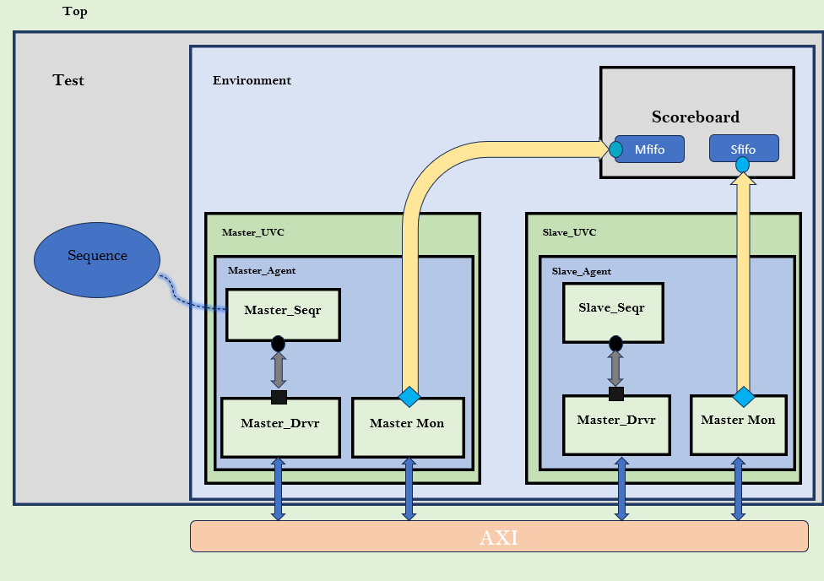
TB Architecture

Slide 9
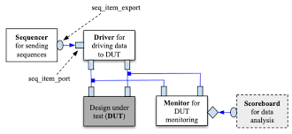
Scoreboard

Slide 10
Conclusion
AXI verification is critical for ensuring high-performance and reliable data transfer in SoCs.
Using UVM, SystemVerilog, and industry-standard tools helps achieve thorough verification and high functional coverage.
Robust AXI verification is essential for meeting the demands of modern digital systems.

Slide 11
Thank You

